Slide 1

Electronics

Slide 2

Plan
Quick intro to the robot
Split into groups of 3-4
Group 1
Assemble the chassis
Solder electronics
Group 2
Circuit design flow

Slide 3
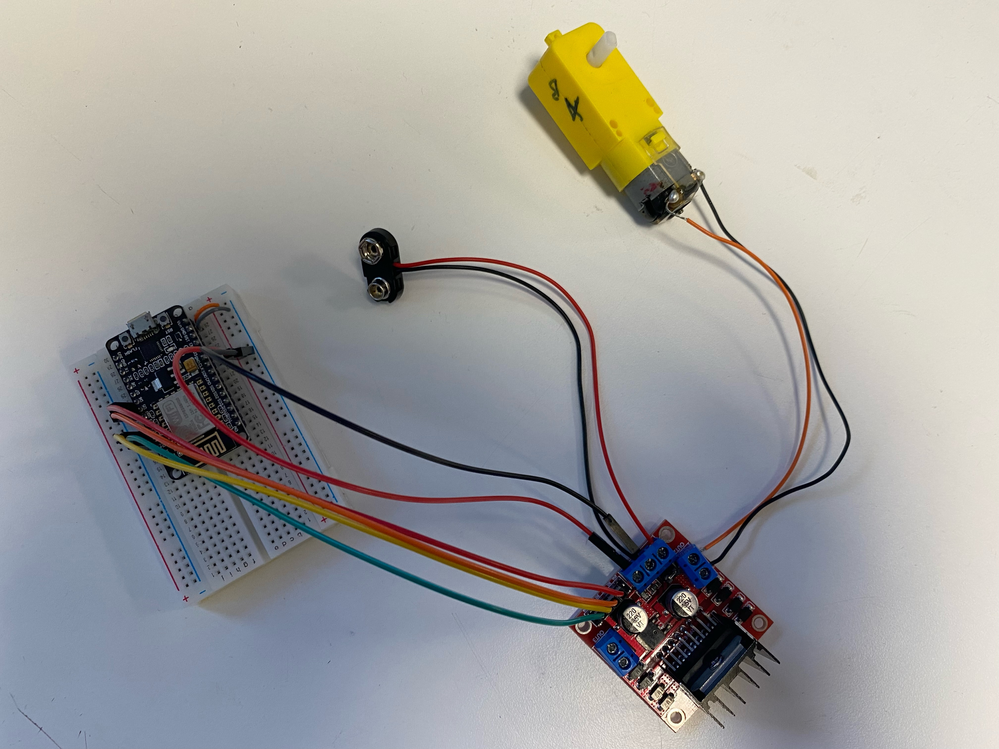
Our robot
The ability to gather data​
Directions sent to the ESP32
The ability to process, or do something with the gathered data​
Data is processed by the ESP32 and gives an output
The ability to interact with the environment
DC motor

Slide 4
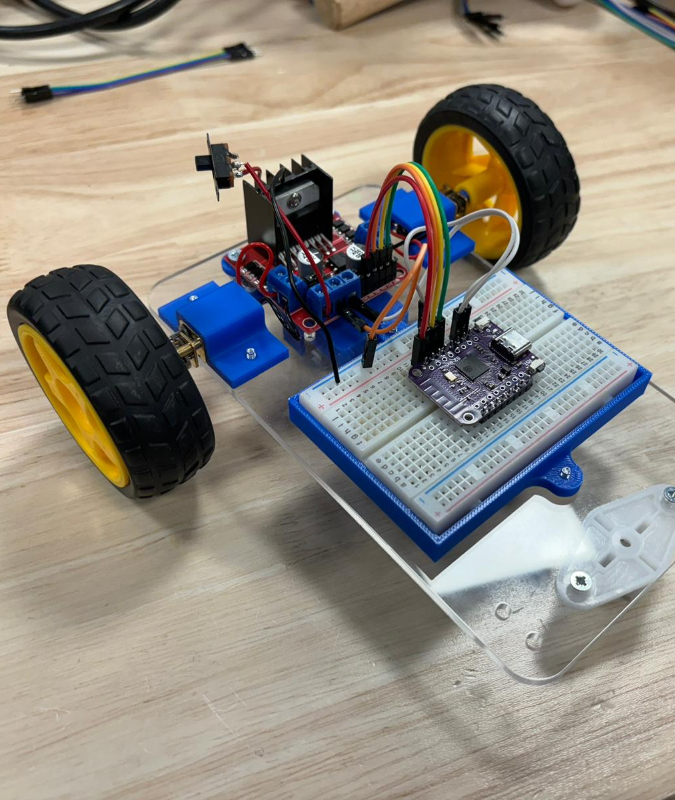
Our robot
The ability to gather data​
Directions sent to the ESP32
The ability to process, or do something with the gathered data​
Data is processed by the ESP32 and gives an output
The ability to interact with the environment
DC motor

Slide 5

Get into your groups

Slide 6
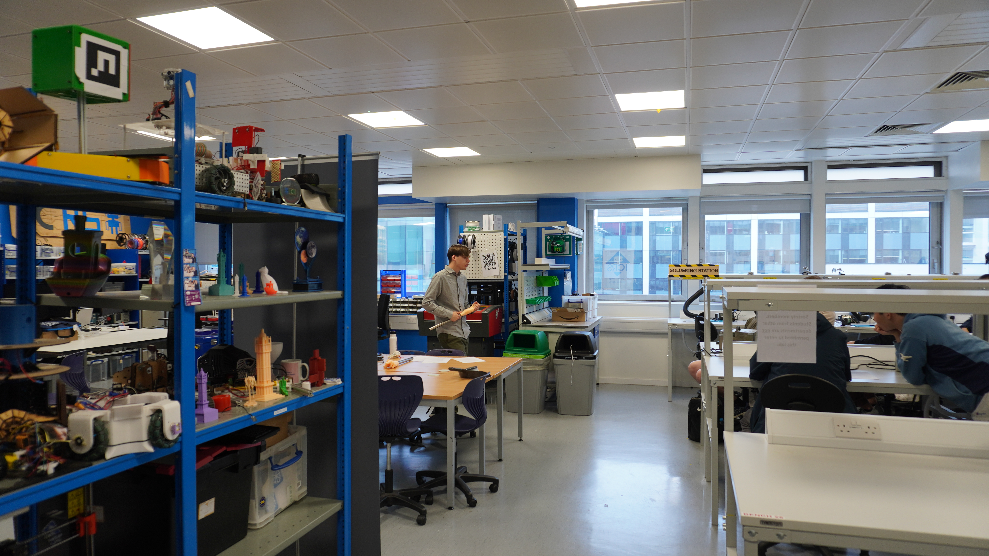
Electronics agenda
1. Overview of circuit design and a simulator
2. Simulating your own circuits
3. General circuits and rover specific circuits

Slide 7
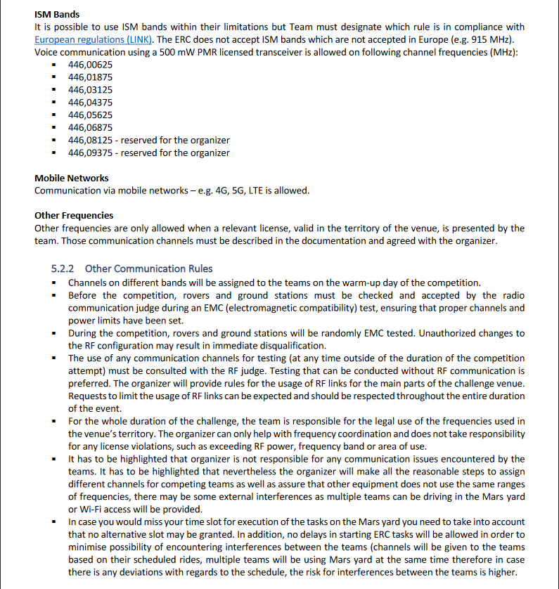
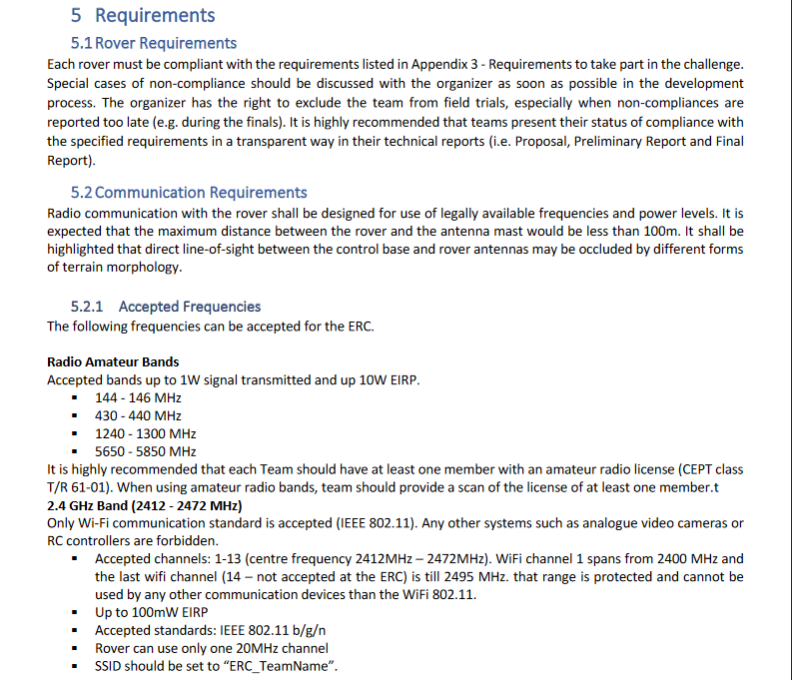
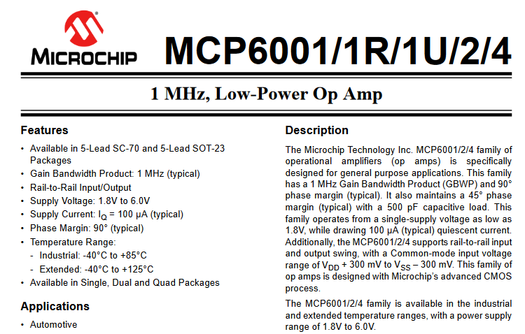
Specification
Can be called a:
Technical proposal
Design specification
Can be written by a customer or supervisor
If it’s self proposed, even better

Slide 8

Design a circuit

Slide 9
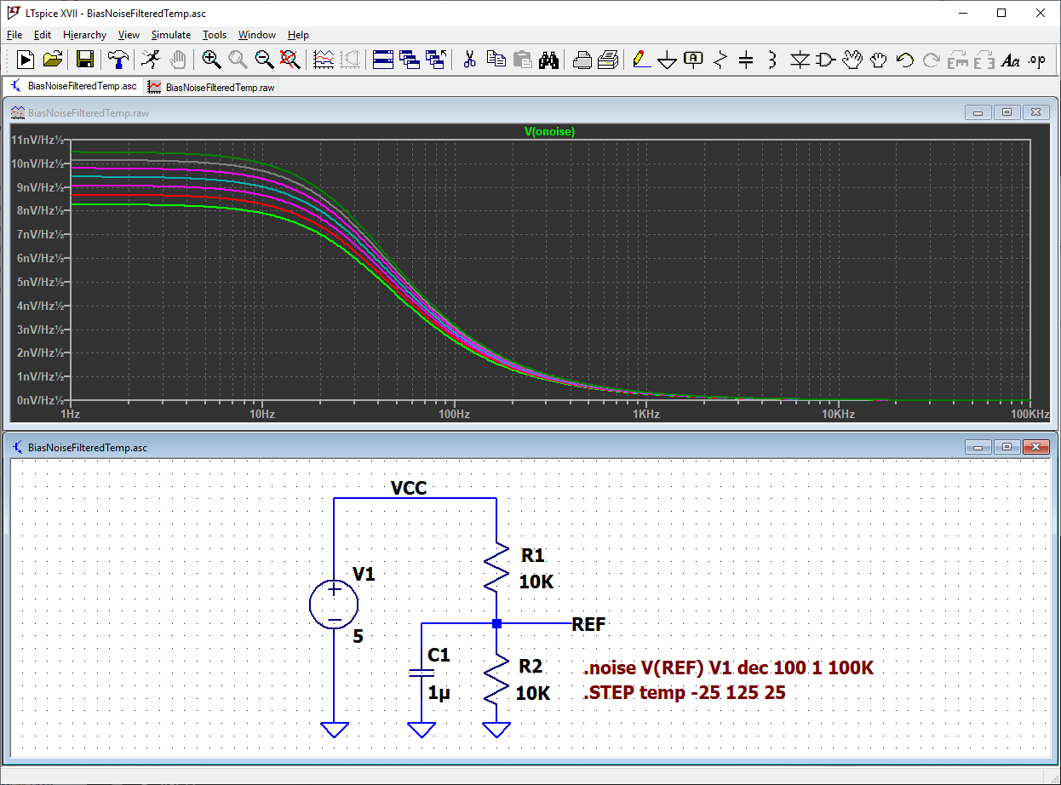
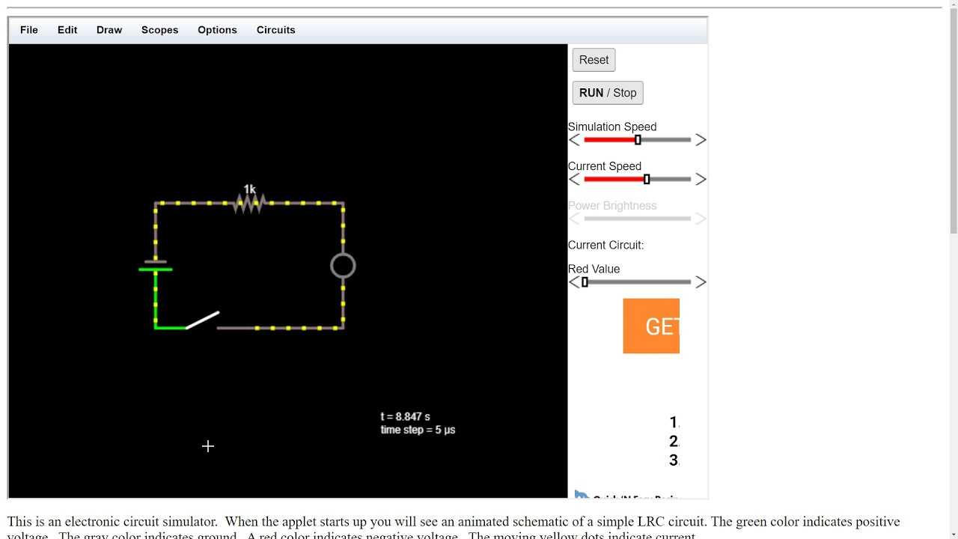
Simulate the circuit
Yes you do have to make sure that it works before prototyping

Slide 10
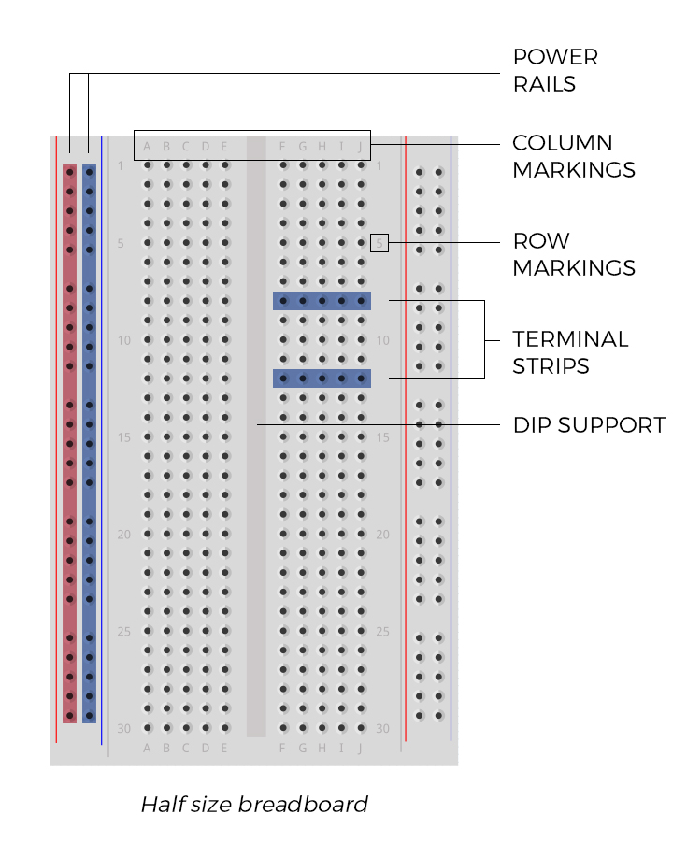
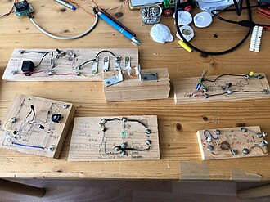
Breadboard
Prototype it on a breadboard

Slide 11
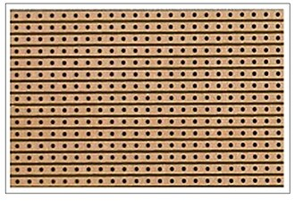
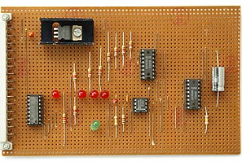
Stripboard/Veroboard/padboard
They’re all technically different, and every single one is better than a breadboard

Slide 12
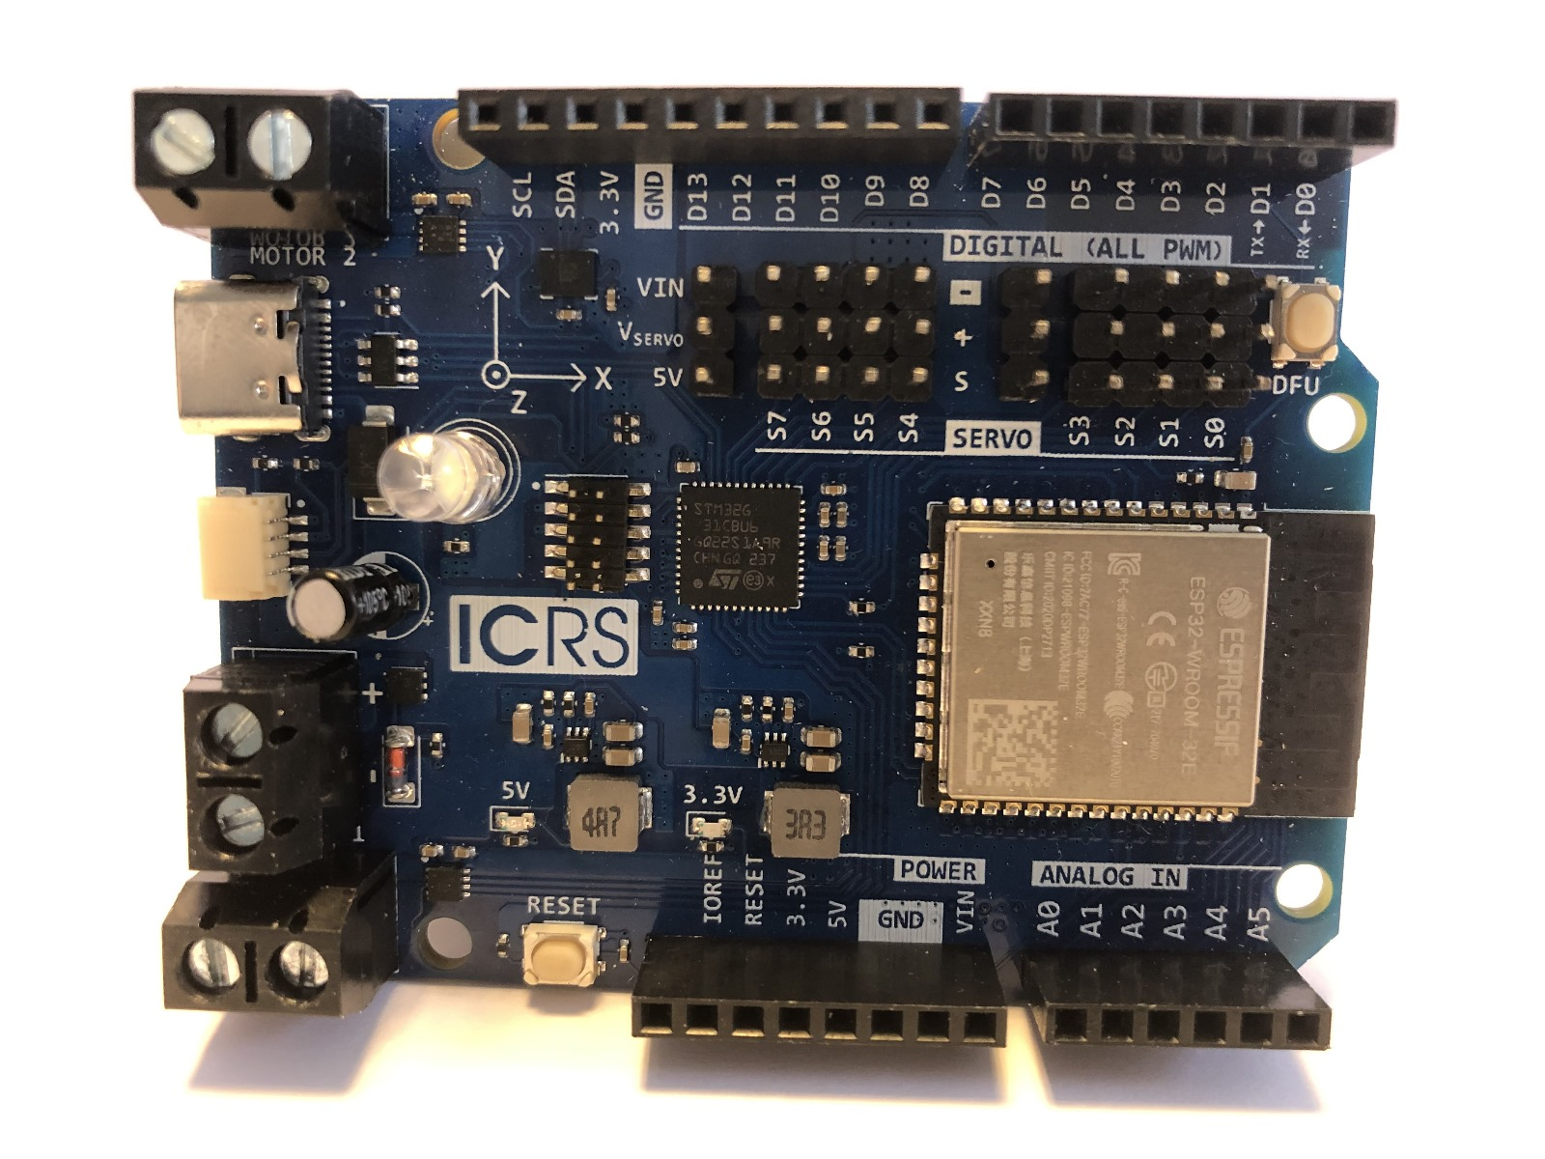
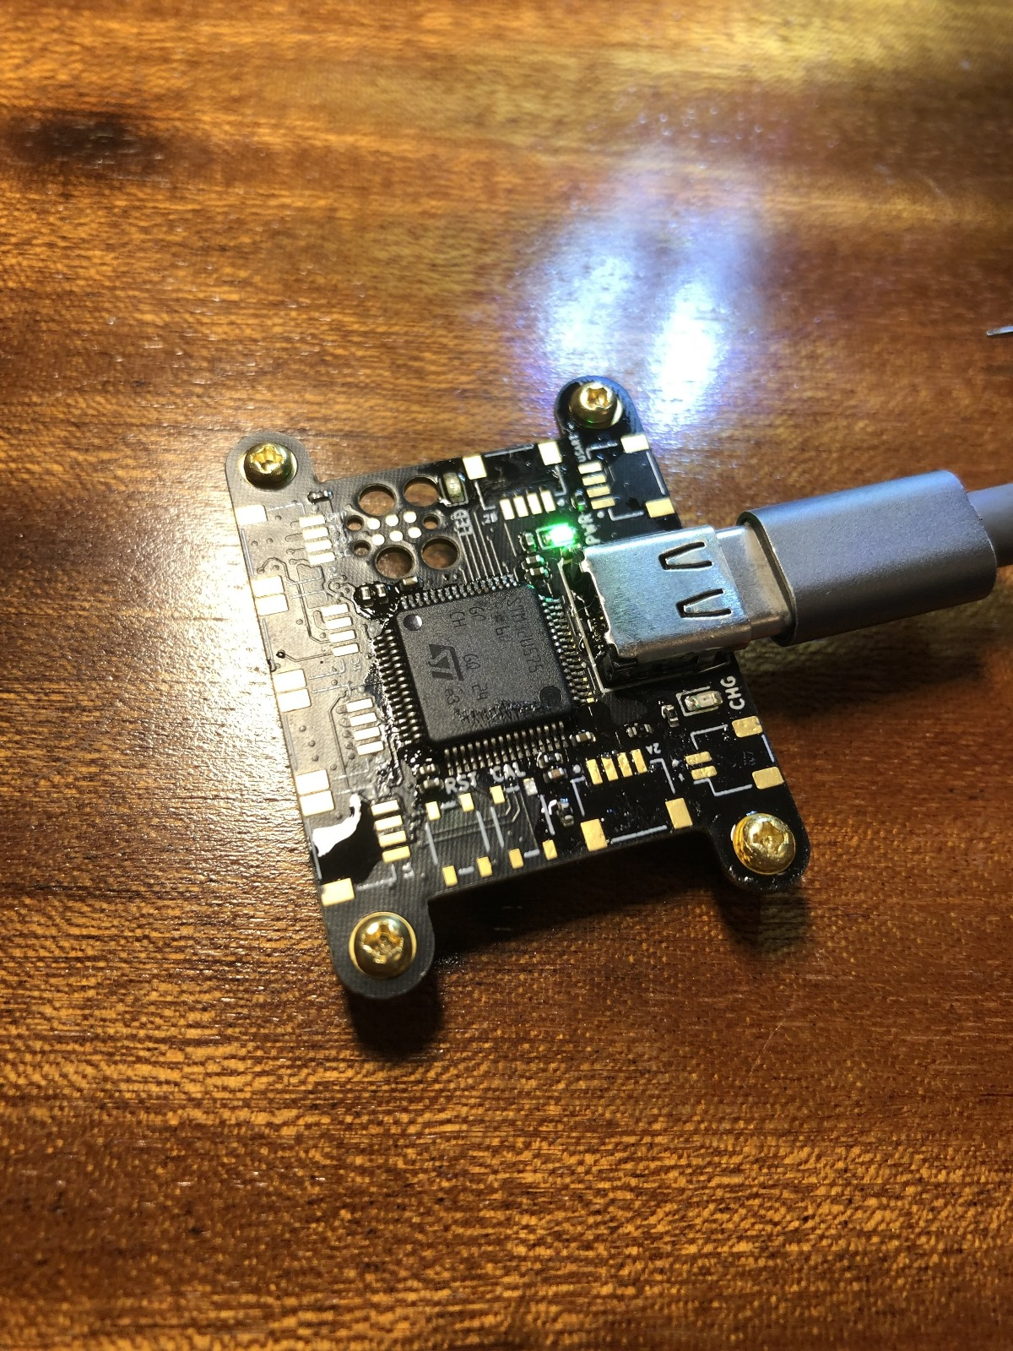
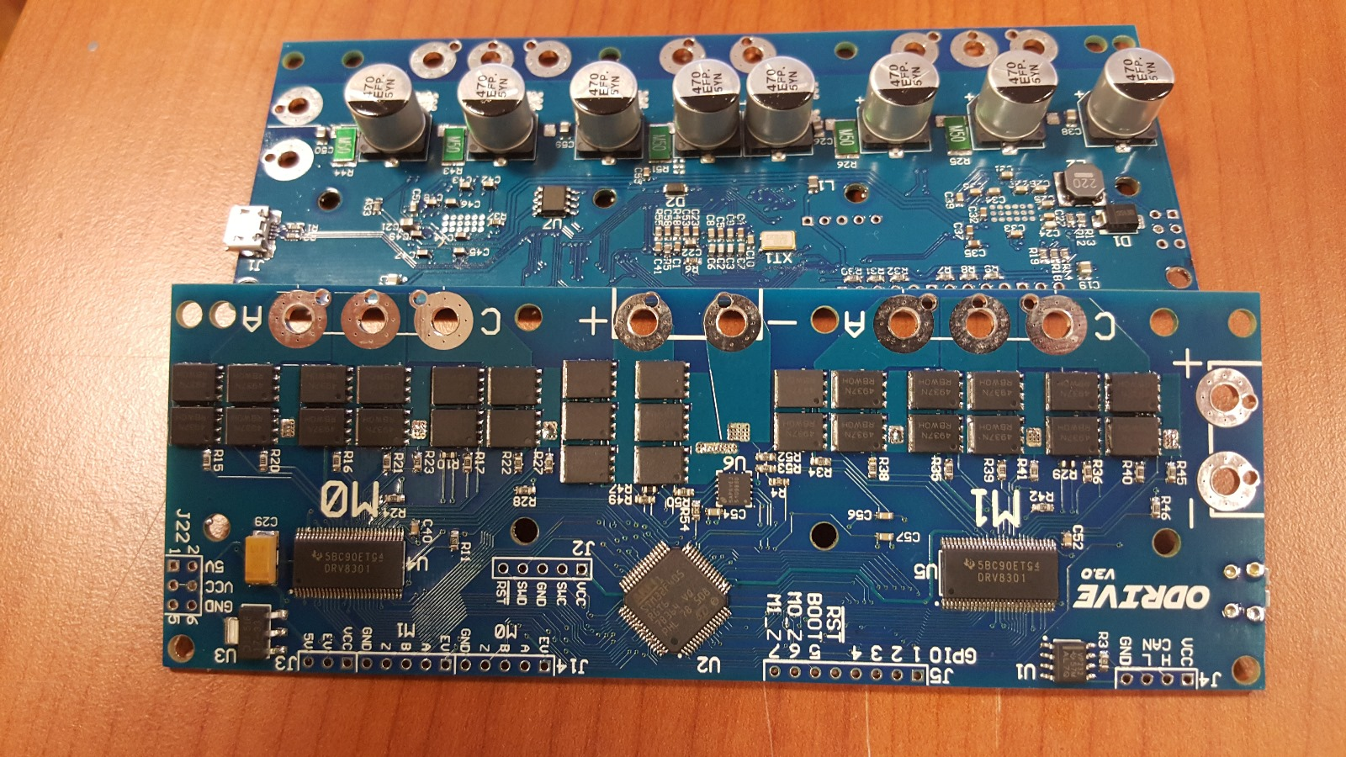
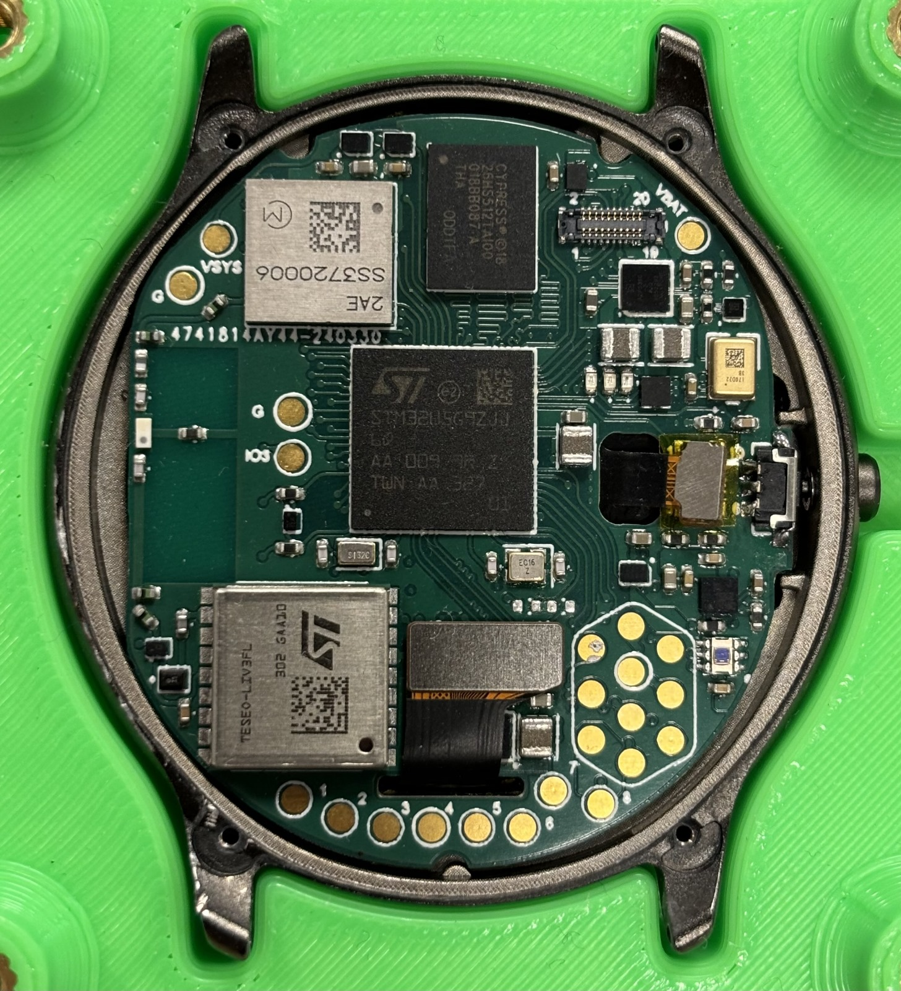
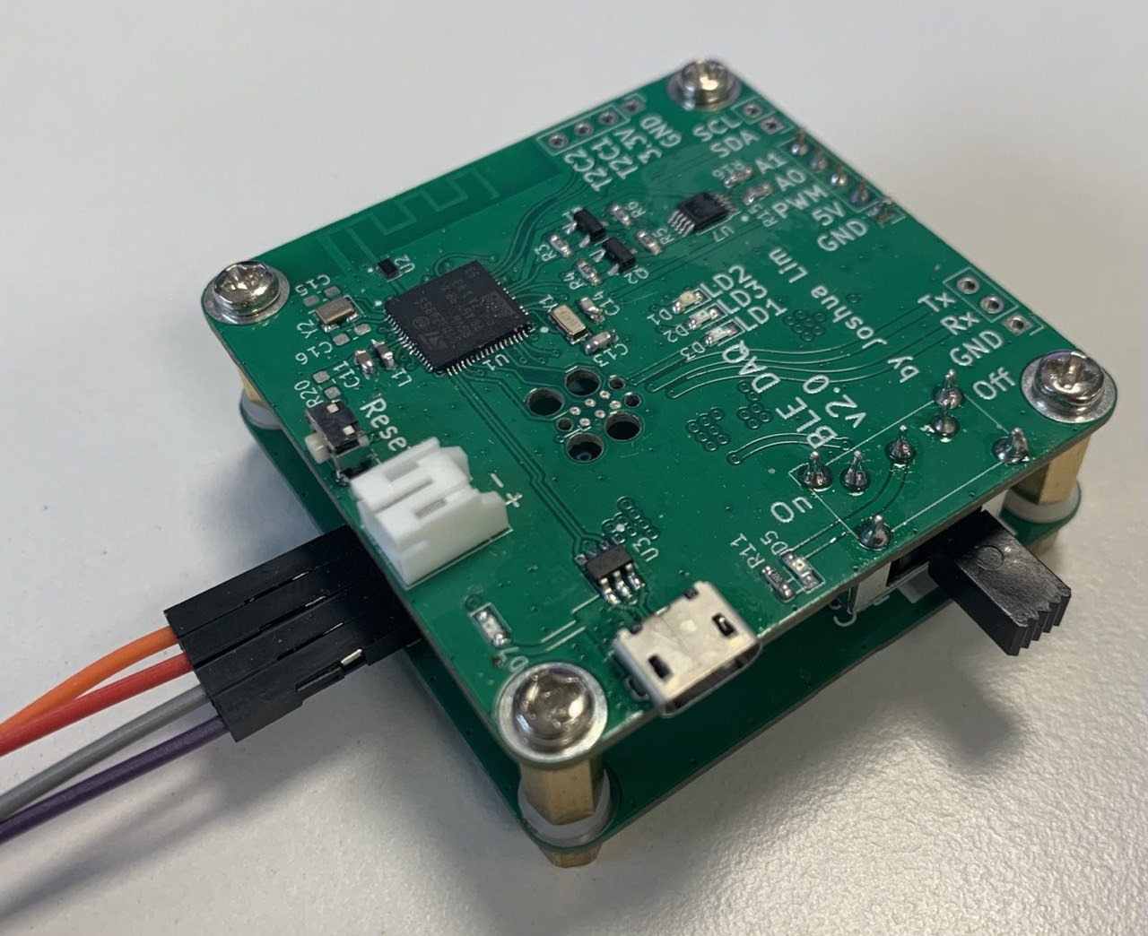
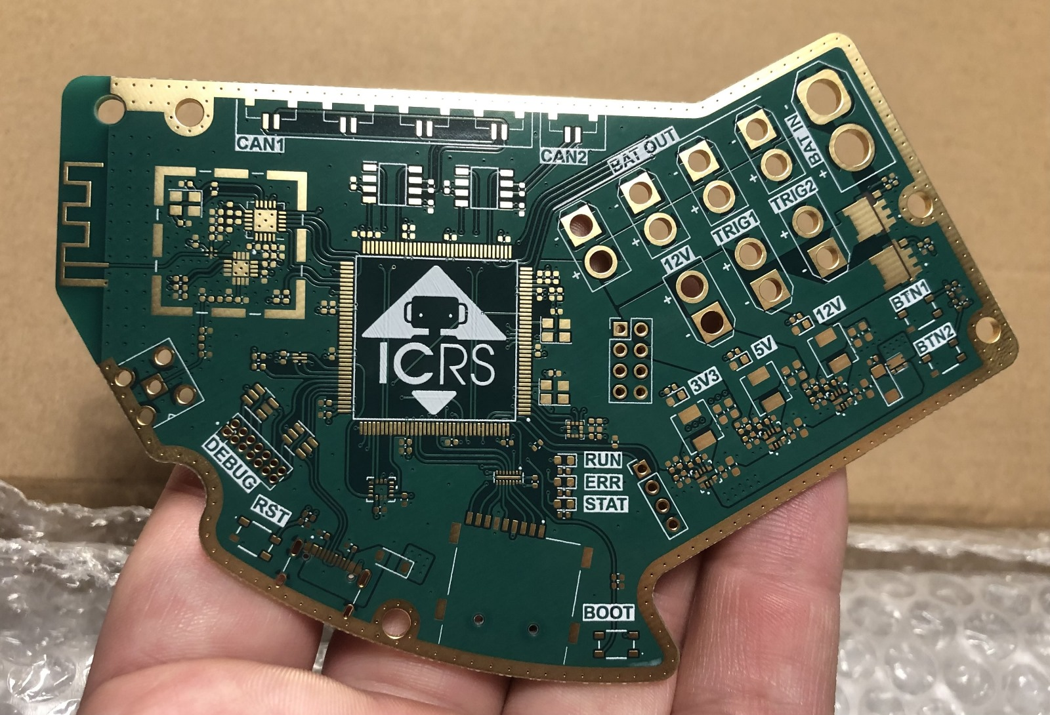
Optional: make a PCB

Slide 13
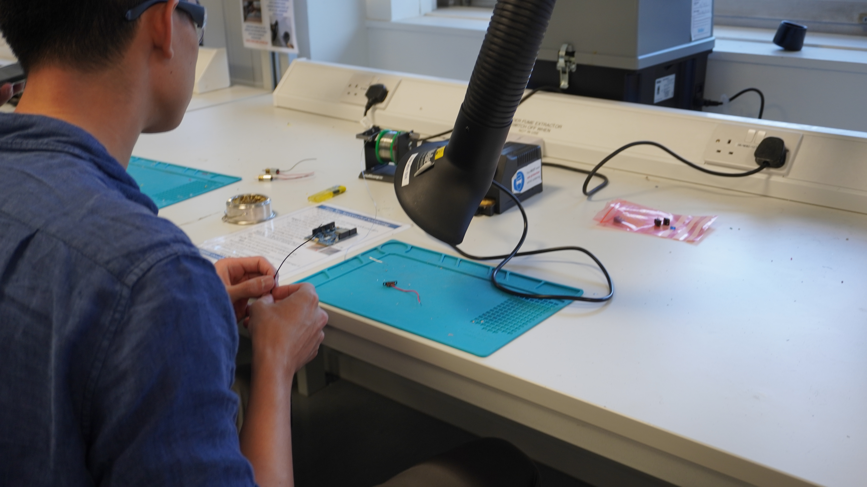
Circuit design summary
Specification
Design the circuit
Simulate the circuit
Breadboard the circuit
Veroboard the circuit
Optional extra: make a PCB
Falstad circuit simulator
https://www.falstad.com/circuit/circuitjs.html

Slide 14
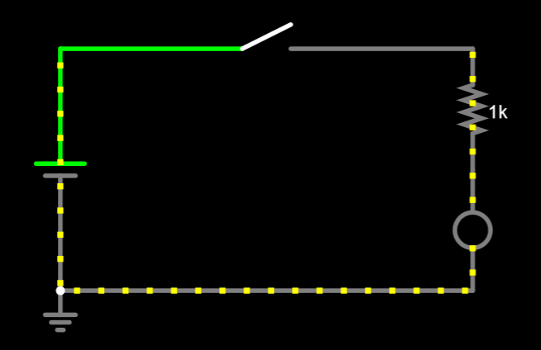
A basic LED and switch

Slide 15
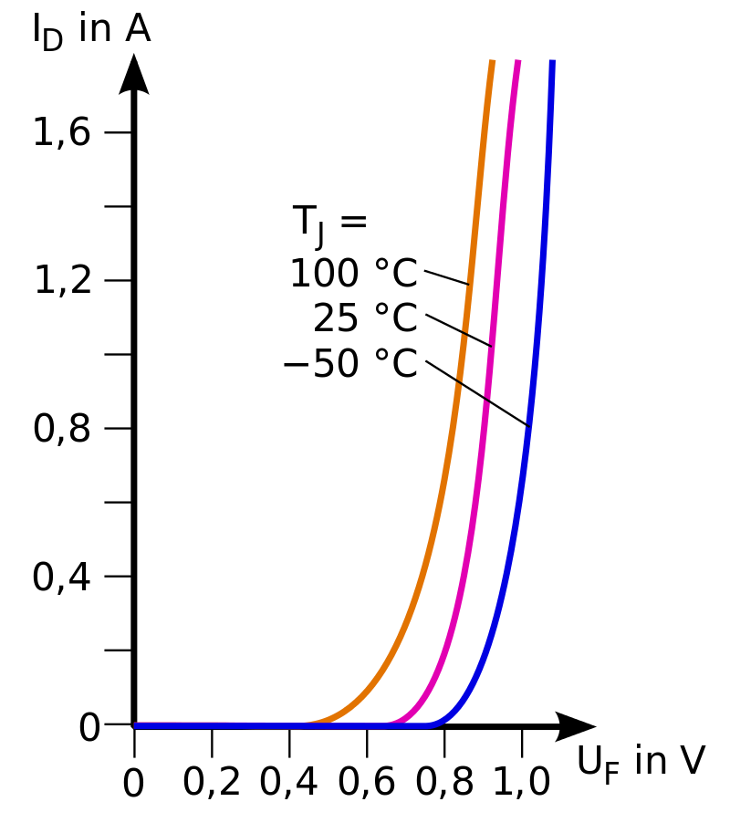
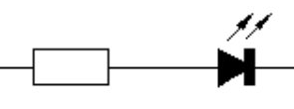
Why do we have resistors along with the LED?
We have the resistor there because the current would explode (or just fizzle) the LED without some way to limit the current
Limiting the current through a resistor is a common technique

Slide 16
What if I want to change the brightness?

Slide 17
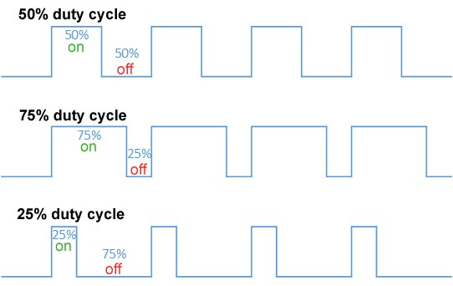
Changing the brightness
We use pulse width modulation (PWM), another important idea

Slide 18
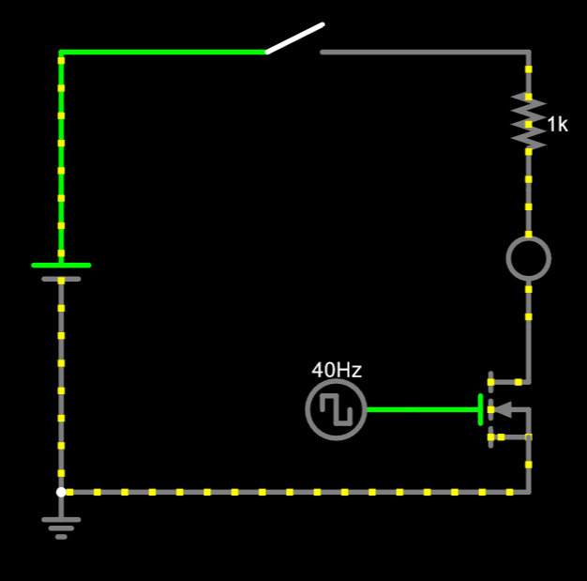
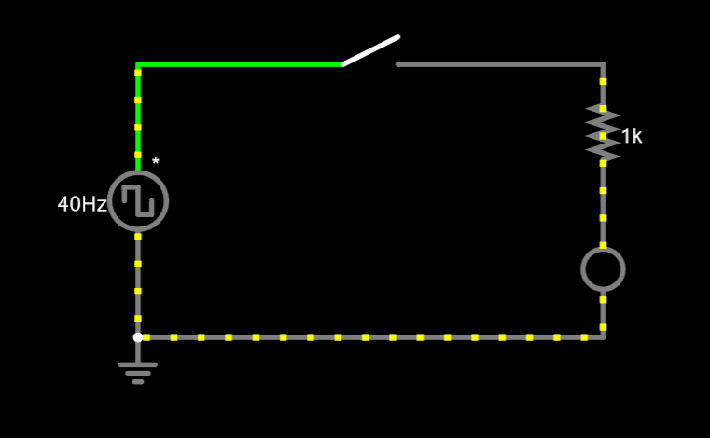
Variable brightness LED

Slide 19
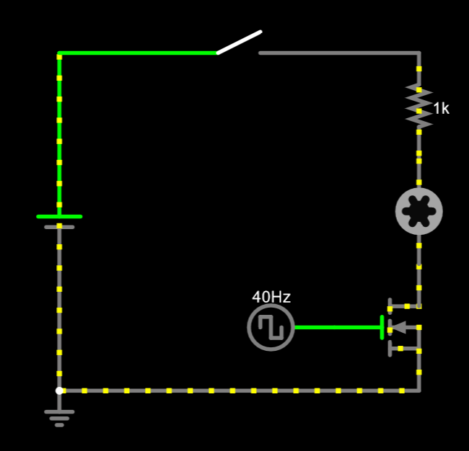
Applied to motors

Slide 20
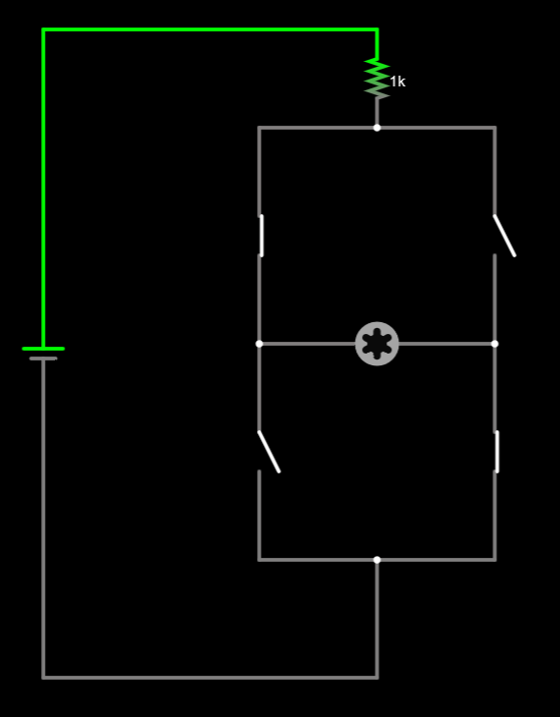
Changing motor directions
We need current to go in both directions to control motor direction
So we make an H-bridge

Slide 21
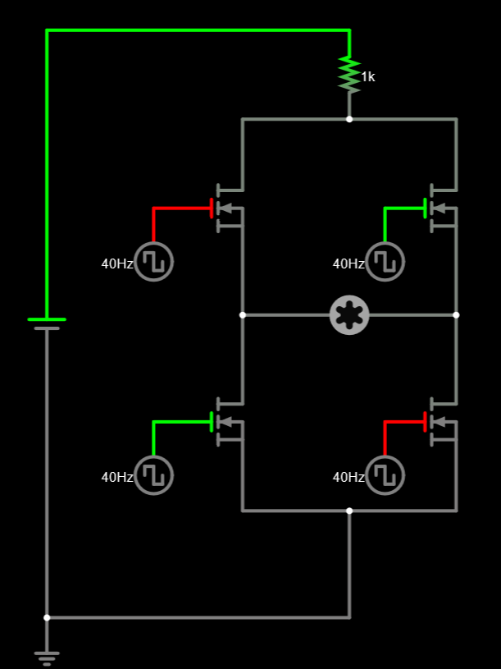
Motor driver
A motor driver is the main part of the robot
We aren’t quite finished though

Slide 22
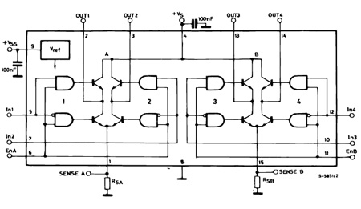
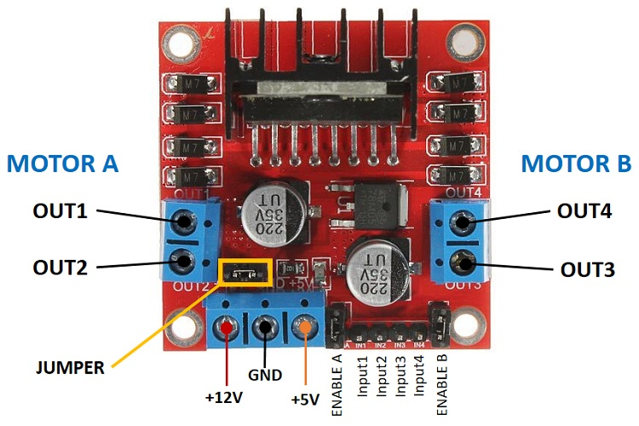
Real motor driver
L298n motor driver

Slide 23
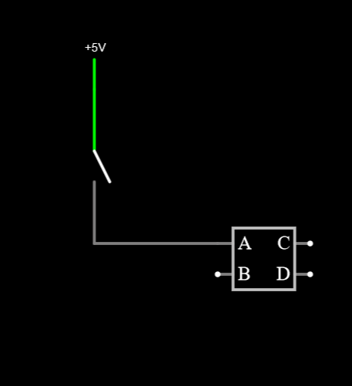
Inputs to the microcontroller
We have a button connected to the input of a microcontroller
The microcontroller will read the input
What is the input voltage when the button is not pressed?

Slide 24
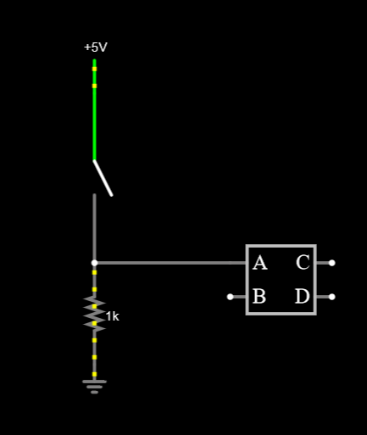
Inputs to the microcontroller
We add a pulldown resistor to force the input voltage down to ground

